Slide 1

What’s New in C# 4.0?
Pavel Yosifovich
SELA Group
pavely@sela.co.il
http://blogs.microsoft.co.il/blogs/pavely
Notes:
© 2008 Microsoft Corporation. All rights reserved. Microsoft, Windows, Windows Vista and other product names are or may be registered trademarks and/or trademarks in the U.S. and/or other countries.
The information herein is for informational purposes only and represents the current view of Microsoft Corporation as of the date of this presentation. Because Microsoft must respond to changing market conditions, it should not be interpreted to be a commitment on the part of Microsoft, and Microsoft cannot guarantee the accuracy of any information provided after the date of this presentation.
MICROSOFT MAKES NO WARRANTIES, EXPRESS, IMPLIED OR STATUTORY, AS TO THE INFORMATION IN THIS PRESENTATION.

Slide 2
Agenda
C# Evolution
Default and Named Arguments
Dynamic Typing
COM Interoperability
Generic Variance
Summary

Slide 3
The Evolution of C#
C# 3.0
Language Integrated Query
C# 2.0
Generics
C# 1.0
Managed Code

Slide 4
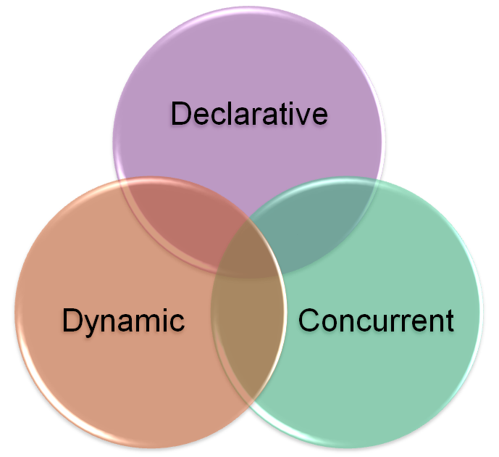
Trends

Slide 5

Declarative Programming
What
How
Imperative
Declarative

Slide 6
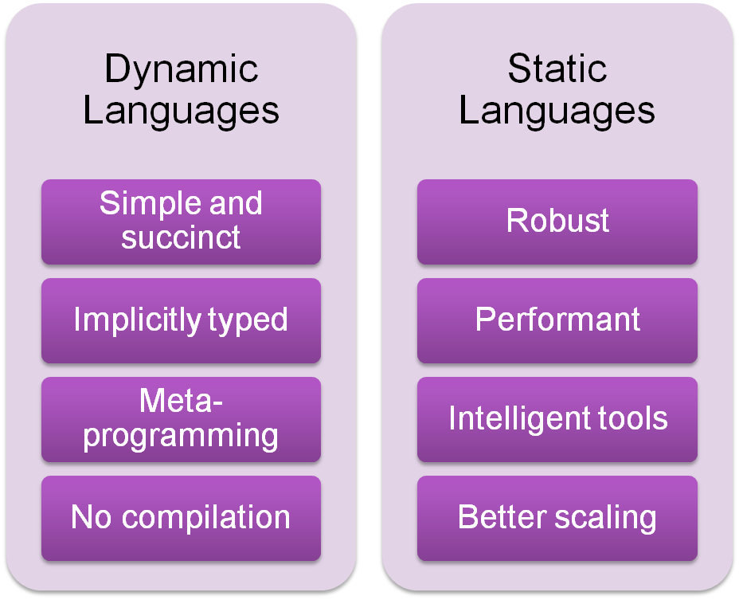
Dynamic vs. Static

Slide 7
The Evolution of C#
C# 4.0
Dynamic Programming
C# 3.0
Language Integrated Query
C# 2.0
Generics
C# 1.0
Managed Code

Slide 8
Optional and Named Parameters
public StreamReader OpenTextFile(
string path,
Encoding encoding,
bool detectEncoding,
int bufferSize);
Primary method
Secondary overloads
public StreamReader OpenTextFile(
string path,
Encoding encoding,
bool detectEncoding);
public StreamReader OpenTextFile(
string path,
Encoding encoding);
public StreamReader OpenTextFile(
string path);
Call primary with default values

Slide 9
Optional and Named Parameters
public StreamReader OpenTextFile(
string path,
Encoding encoding,
bool detectEncoding,
int bufferSize);
Optional parameters
public StreamReader OpenTextFile(
string path,
Encoding encoding = null,
bool detectEncoding = true,
int bufferSize = 1024);
Named argument
OpenTextFile("foo.txt", Encoding.UTF8);
OpenTextFile("foo.txt", Encoding.UTF8, bufferSize: 4096);
Named arguments can appear in any order
Arguments evaluated in order written
Named arguments must be last
OpenTextFile(
bufferSize: 4096,
path: "foo.txt",
detectEncoding: false);
Non-optional must be specified

Slide 10
Named & Optional Parameters
Caveats
  Parameter names
  Evaluation order
  Virtual methods

Slide 11






.NET Dynamic Programming
IronPython
IronRuby
C#
VB.NET
Others…
Dynamic Language Runtime
Expression Trees
Dynamic Dispatch
Call Site Caching
Object
Binder
JavaScript
Binder
Python
Binder
Ruby
Binder
COM
Binder

Slide 12
Dynamically Typed Objects
Calculator calc = GetCalculator();
int sum = calc.Add(10, 20);
object calc = GetCalculator();
Type calcType = calc.GetType();
object res = calcType.InvokeMember("Add",
BindingFlags.InvokeMethod, null,
new object[] { 10, 20 });
int sum = Convert.ToInt32(res);
ScriptObject calc = GetCalculator();
object res = calc.Invoke("Add", 10, 20);
int sum = Convert.ToInt32(res);
Statically typed to be dynamic
dynamic calc = GetCalculator();
int sum = calc.Add(10, 20);
Dynamic conversion
Dynamic method invocation

Slide 13
Dynamically Typed Objects
Compile-time type
dynamic
Run-time type
System.Int32
dynamic x = 1;
dynamic y = "Hello";
dynamic z = new List<int> { 1, 2, 3 };
When operand(s) are dynamic…
Member selection deferred to run-time
At run-time, actual type(s) substituted for dynamic
Static result type of operation is dynamic

Slide 14
Dynamically Typed Objects
public static class Math
{
public static decimal Abs(decimal value);
public static double Abs(double value);
public static float Abs(float value);
public static int Abs(int value);
public static long Abs(long value);
public static sbyte Abs(sbyte value);
public static short Abs(short value);
...
}
Method chosen at compile-time:
double Abs(double x)
double x = 1.75;
double y = Math.Abs(x);
Method chosen at run-time:
double Abs(double x)
dynamic x = 1.75;
dynamic y = Math.Abs(x);
Method chosen at run-time:
int Abs(int x)
dynamic x = 2;
dynamic y = Math.Abs(x);

Slide 15

Improved COM Interoperability
object fileName = "Test.docx";
object missing = System.Reflection.Missing.Value;
doc.SaveAs(ref fileName,
ref missing, ref missing, ref missing,
ref missing, ref missing, ref missing,
ref missing, ref missing, ref missing,
ref missing, ref missing, ref missing,
ref missing, ref missing, ref missing);
doc.SaveAs("Test.docx");

Slide 16
Improved COM Interoperability
Automatic object → dynamic mapping
Optional and named parameters
Indexed properties
Optional “ref” modifier
Interop type embedding (“No PIA”)

Slide 17
Co- and Contra-variance
.NET arrays are co-variant
string[] strings = GetStringArray();
Process(strings);
void Process(object[] objects) { … }
…but not safely
co-variant
void Process(object[] objects) {
objects[0] = "Hello"; // Ok
objects[1] = new Button(); // Exception!
}
Until now, C# generics have been invariant
List<string> strings = GetStringList();
Process(strings);
C# 4.0 supports safe co- and contra-variance
void Process(IEnumerable<object> objects) { … }
void Process(IEnumerable<object> objects) {
// IEnumerable<T> is read-only and
// therefore safely co-variant
}

Slide 18
Safe Co- and Contra-variance
public interface IEnumerable<T>
{
IEnumerator<T> GetEnumerator();
}
public interface IEnumerable<out T>
{
IEnumerator<T> GetEnumerator();
}
out = Co-variant
Output positions only
Can be treated as
less derived
public interface IEnumerator<T>
{
T Current { get; }
bool MoveNext();
}
public interface IEnumerator<out T>
{
T Current { get; }
bool MoveNext();
}
IEnumerable<string> strings = GetStrings();
IEnumerable<object> objects = strings;
in = Contra-variant
Input positions only
public interface IComparer<T>
{
int Compare(T x, T y);
}
public interface IComparer<in T>
{
int Compare(T x, T y);
}
Can be treated as
more derived
IComparer<object> objComp = GetComparer();
IComparer<string> strComp = objComp;

Slide 19
Variance in C# 4.0
Supported for interface and delegate types
“Statically checked definition-site variance”
Value types are always invariant
  IEnumerable<int> is not IEnumerable<object>
  Similar to existing rules for arrays
ref and out parameters need invariant type

Slide 20
Variance in .NET Framework 4.0
Interfaces
  System.Collections.Generic.IEnumerable<out T>
  System.Collections.Generic.IEnumerator<out T>
  System.Linq.IQueryable<out T>
  System.Collections.Generic.IComparer<in T>
  System.Collections.Generic.IEqualityComparer<in T>
  System.IComparable<in T>
Delegates
  System.Func<in T, …, out R>
  System.Action<in T, …>
  System.Predicate<in T>
  System.Comparison<in T>
  System.EventHandler<in T>

Slide 21
Summary
Optional and Named Arguments
Dynamic Typing
Generic Variance
Easier COM Interoperability

